Slide 1
A Pathway by Any Other Name: Guided Pathways and Get Focused Stay Focused
Kathy Booth
March 26, 2018
Download this presentation: bit.ly/gfsf-gp

Slide 2
CCPT on career pathways
Career pathway programs are intended to prepare students for high-skill, high-wage jobs in emerging and growing industry sectors in the local or regional economy.
California Department of Education
California Career Pathways Trust (CCPT) website

Slide 3
WIOA (and Perkins) on career pathways
A combination of rigorous and high-quality education, training, and other services that:
aligns with the skill needs of industries in the economy of the state or regional economy involved
prepares an individual to be successful in any of a full range of secondary or postsecondary education options, including apprenticeships
includes counseling to support an individual in achieving the individual’s education and career goals
includes, as appropriate, education offered concurrently with and in the same context as workforce preparation activities and training for a specific occupation or occupational cluster
organizes education, training, and other services to meet the particular needs of an individual in a manner that accelerates the educational and career advancement of the individual to the extent practicable
enables an individual to attain a secondary school diploma or its recognized equivalent, and at least 1 recognized postsecondary credential
helps an individual enter or advance within a specific occupation or occupational cluster. .
Workforce Innovation and Opportunity Act (WIOA)

Slide 4
AACC on guided pathways
Coherent and easy-to-follow college-level programs of study that are aligned with requirements for success in employment and the next stage of education.
Programs, support services, and instructional approaches are redesigned and re-aligned to help students:
clarify their goals
choose and enter pathways that will achieve those goals
stay on those pathways
master knowledge and skills that will enable them to advance in the labor market and successfully pursue further education
The Pathways Project, American Association of Community Colleges

Slide 5
EQUITY

Slide 6
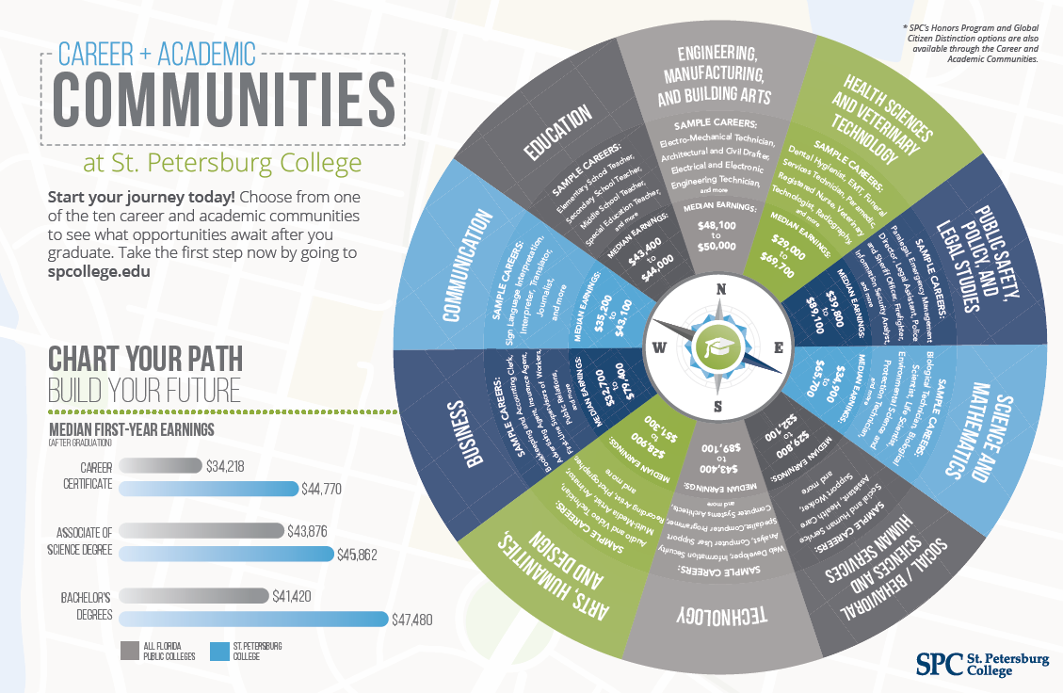

Slide 7
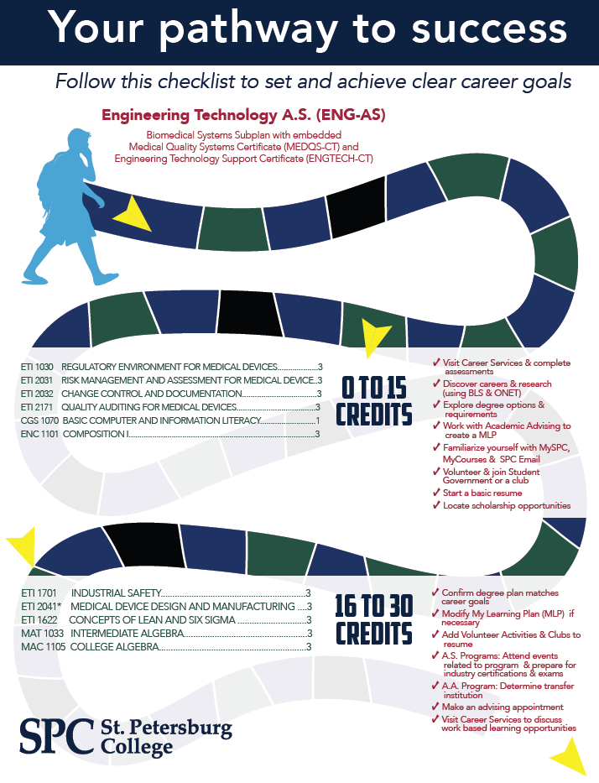
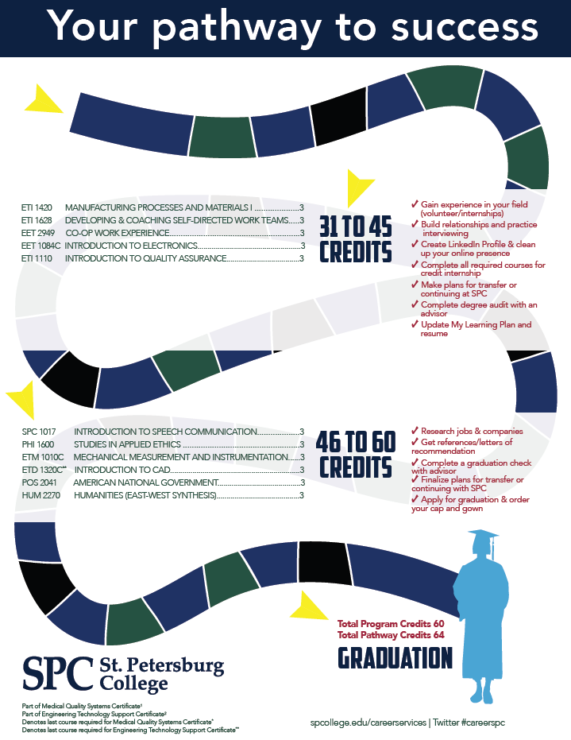

Slide 8
What are guided pathways?
NO | YES
Just for specific programs, like CTE, MESA, or EOPS | For all programs and students
Is a discrete initiative, like learning communities | A framework for existing improvement initiatives
Eliminates liberal arts majors and focuses narrowly on careers | Includes general education, both within and across pathways, in service of students’ short- and long-term goals
Tracks students into options that can’t be changed | Fosters student exploration of their interests
Imposes a national model that doesn’t fit California’s context | Builds on efforts already underway and can be flexibly adapted to local contexts

Slide 9
Guided pathways support long-term career pathways
It’s more than just completion:
Meta-majors help students find the pathway that best fits their interests and aspirations.
Guided pathways intentionally blends CTE and non-CTE offerings to help students build the complex skillsets they will need to change careers and advance up career ladders over time.

Slide 10
Guided pathways will incentivize career and major exploration in high school
While stronger advising will help students get on a path and meta-majors will help students explore options within the curriculum, colleges will be better able to shorten time to degree if students arrive with a stronger sense of their goals and options.
That’s where GFSF fits in.

Slide 11
Having an area of interest isn’t enough.

Slide 12
Students select majors based on faulty information
The main determinants of major choice are beliefs about course enjoyment and grades.
While students indicate that labor market outcomes matter:
Less than 40% of students rank broad categories of majors accurately in terms of labor market outcomes.
Students believe that salaries are 13% higher than they actually are.
Students underestimate the probability of being employed by almost 25%.
The effect of labor market information on community college students major choice

Slide 13
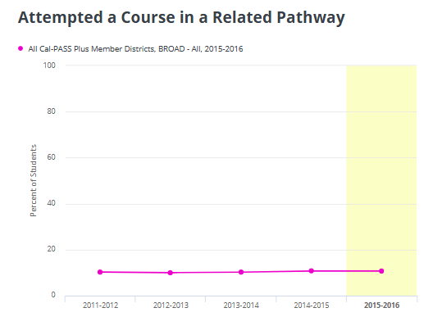
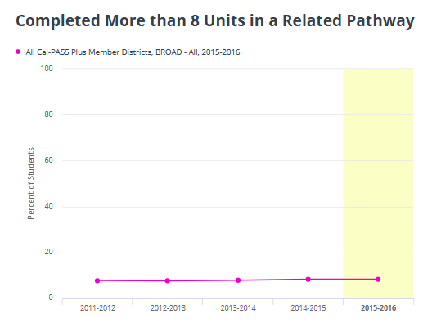
Students with exposure to a pathway
don’t make progress once in college

Slide 14
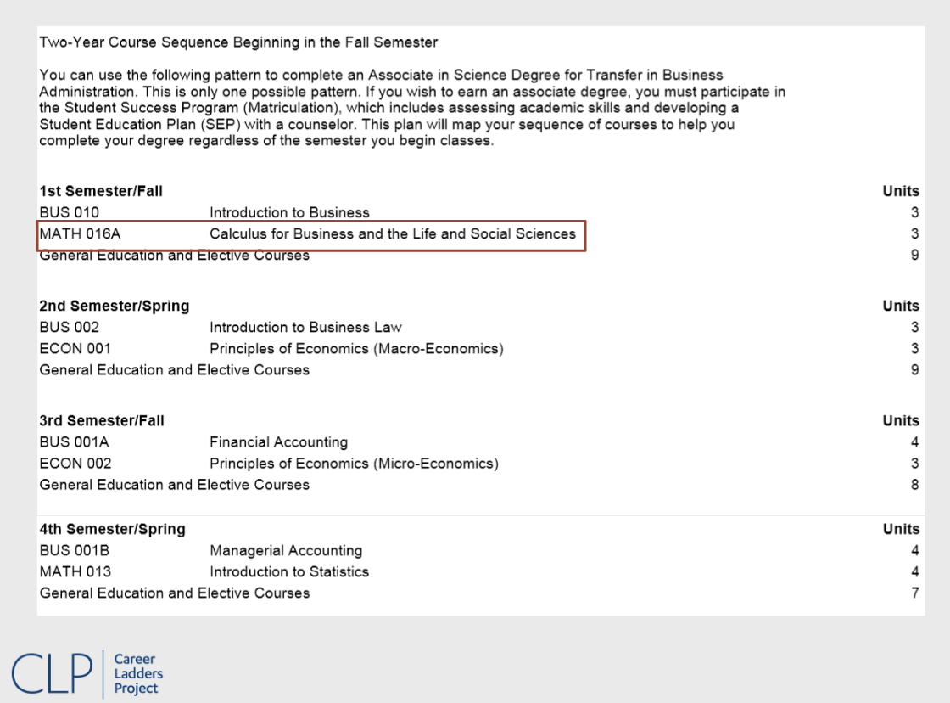
Math and English requirements become barriers

Slide 17
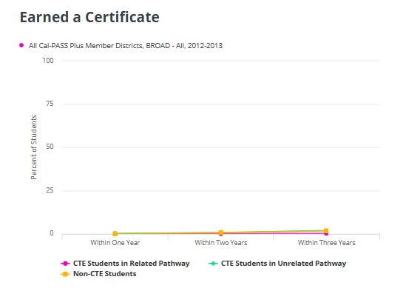
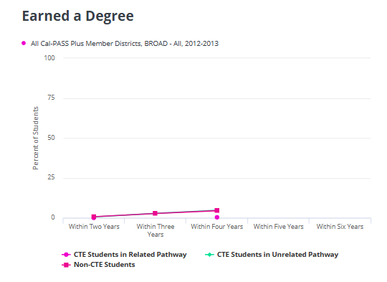
Essentially, no students are completing within two years

Slide 18
What would it mean
to align GFSF with guided pathways?

Slide 19
Help students understand how their interests relate to the job market
Enable students to become more sophisticated consumers of labor market information.
Ensure they are examining multiple variables like core skills and temperament, in addition to educational requirements and salaries.

Slide 20
Link GFSF to other college-readiness efforts
How can you alert students to the importance of math and English skills?
What CTE pathways are available that would allow students to do hands-on exploration in high school?
Are there dual enrollment options that allow students to experience college-level coursework?

Slide 21
Understand how nearby colleges are implementing meta-majors
Colleges may call meta-majors by various names (schools, houses, interest clusters, career clusters, pathways…)
Colleges will have different meta-majors, although there are likely to be similarities (arts & humanities, business, education, engineering/construction, health, social sciences, STEM/ICT)
Focus on the foundational skills and career/transfer options associated with each meta-major

Slide 22
Find out more
Visit the Chancellor’s Office guided pathways website: http://cccgp.cccco.edu/
Access the California Guided Pathways project website: www.caguidedpathways.org
Download this PowerPoint: bit.ly/gfsf-gp
Email me: kbooth@wested.org

Slide 23
What are your questions?

